Slide 1
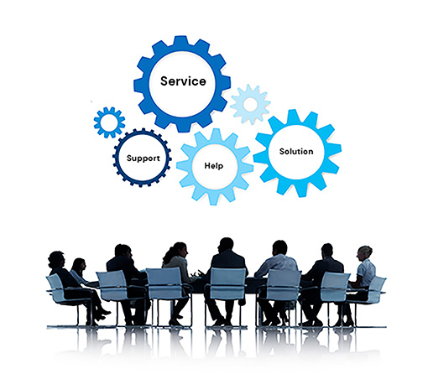
Problem Statement:
Integrated Common Services To Common People
Access all public services in one place
Imagine a world where accessing essential services is effortless and efficient. Integrated common services aim to streamline the process, connecting individuals with the solutions they need seamlessly.

Slide 2
Identifying the Need for Integrated Services
Fragmented Services
Time-Consuming Processes
Individuals often encounter fragmented systems, requiring them to visit multiple offices for different services.
Navigating bureaucratic processes can be time-consuming and frustrating, hindering productivity and impacting well-being.
Lack of Information
Digital Divide
Individuals may struggle to access information about available services and their eligibility criteria.
Not everyone has equal access to technology, creating barriers for those who rely on traditional methods.

Slide 3



Overcoming Barriers to Integrated Service
Implementation
Invest in Technology
Data Sharing Agreements
Citizen-Centric Design
Modernizing systems and adopting interoperable technologies is essential for data exchange and seamless service delivery.
Developing agreements to facilitate secure data sharing between agencies enhances efficiency and reduces duplication of effort.
Designing services with the needs of citizens in mind ensures accessibility, ease of use, and a positive user experience.

Slide 4
Website Structure
Brief description of the overall structure including header, navigation, search bar, main content sections, and footer.
Header: Contains the title of the website and a brief tagline.
Navigation: Provides links to various sections of the website.
Search Bar: Allows users to search for specific services
Main Content: Health Services, Education Services and Transportation Services
Footer: Contains the copyright notice and additional info.

Slide 5
Health Services:
Description: Provides information about healthcare resources, hospitals, and clinics.
Additional Information:
Hospitals and Clinics: Directory of local hospitals and clinics with contact information and services offered.
Emergency Services: Information on emergency contacts and services.
Education Services:
Description: Details on schools, colleges, and educational programs.
Additional Information:
Schools and Colleges: Directory of local schools and colleges with contact information and programs offered.
Educational Resources: Articles, e-books, and other resources for students and educators.
Transportation Services:
Description: Public transport information, schedules, and routes.
Additional Information:
Public Transit: Information on bus and train schedules, routes, and fare details.
Ride-Sharing: Access to ride-sharing services and apps.

Slide 6
Conclusion:
The "Integrated Common Services for Common People" website is designed to centralize access to various public services, making it easier for users to find and utilize the resources they need.
The website features a comprehensive structure, including sections for Health, Education, Transportation, and Social Services, each providing detailed and useful information.
Users can easily navigate through the website, search for specific services.
By offering a single point of access for diverse public services, the platform aims to improve user experience and streamline the process of accessing essential services.
The inclusion of up-to-date information and resources helps users make informed decisions and find the support they need efficiently.
By,
Nisarga K R
4th Semester
AIML Branch
G M Institute of Technology
Thank You

